Slide 1
Serverless with Webtask

Slide 2
Building Stupid Stuff for Fun and Games (and Learning) but Mainly for Fun!

Slide 3

I'm Ray
raymondcamden@gmail.com
www.raymondcamden.com
@raymondcamden
Jobless Bum (hire me so I can feed my 200 kids and animals)

Slide 4
What is Serverless?

Slide 5


Slide 6


Slide 7
Building Cool Crap Easily and Quickly

Slide 8
Example 1 - Contact Fixer
(Not serverless but that's ok...)

Slide 9
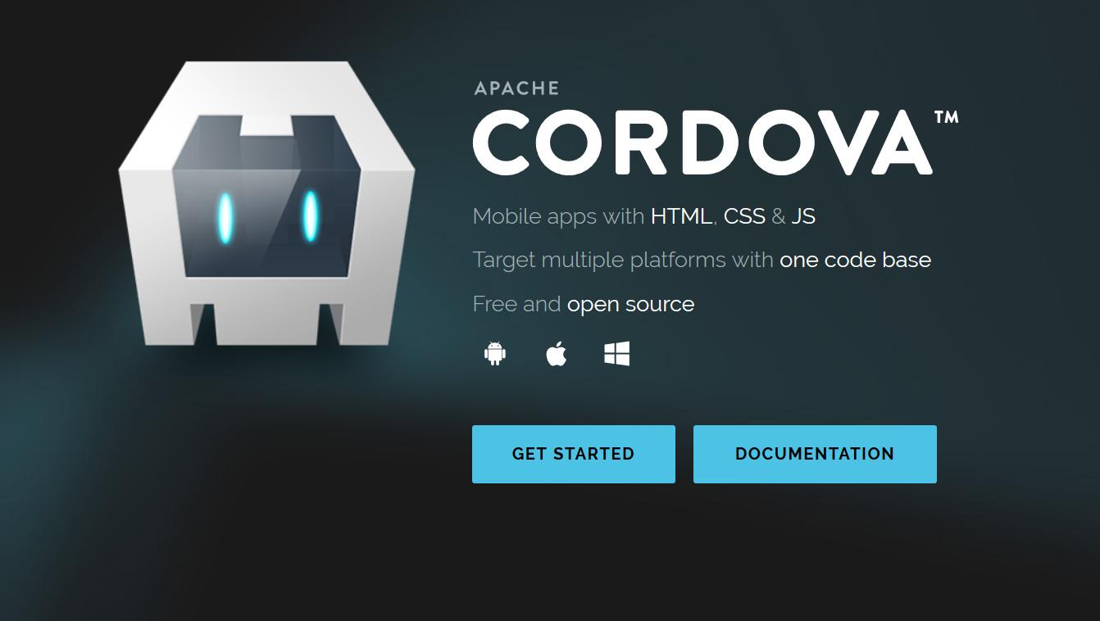

Slide 10
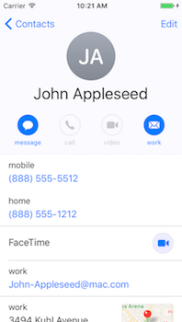
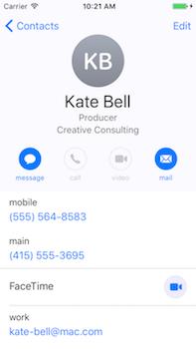
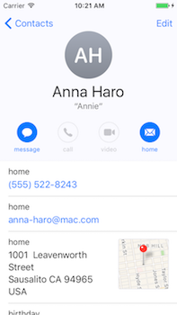

Slide 11
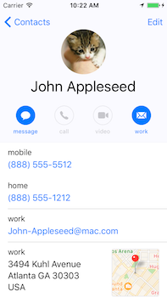
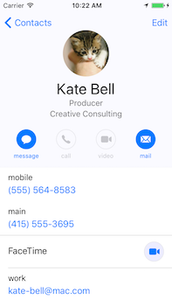
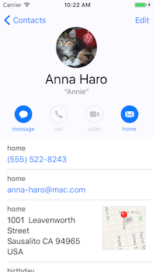

Slide 12
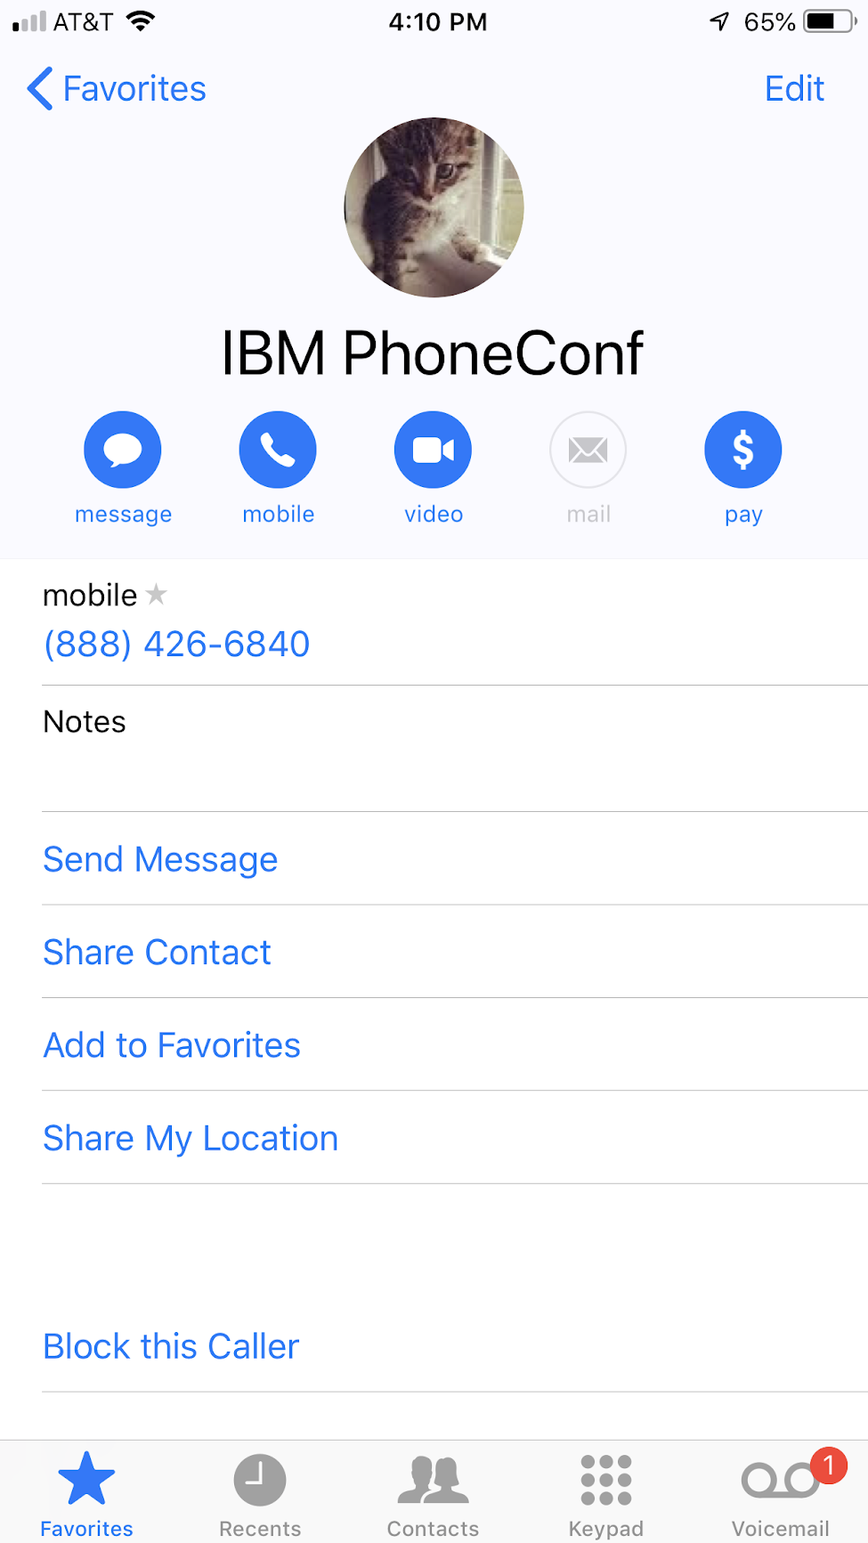

Slide 13
Example 2 - Random Comic Books
(Serverless!!)

Slide 14


Slide 15


Slide 16


Slide 17


Slide 18


Slide 19
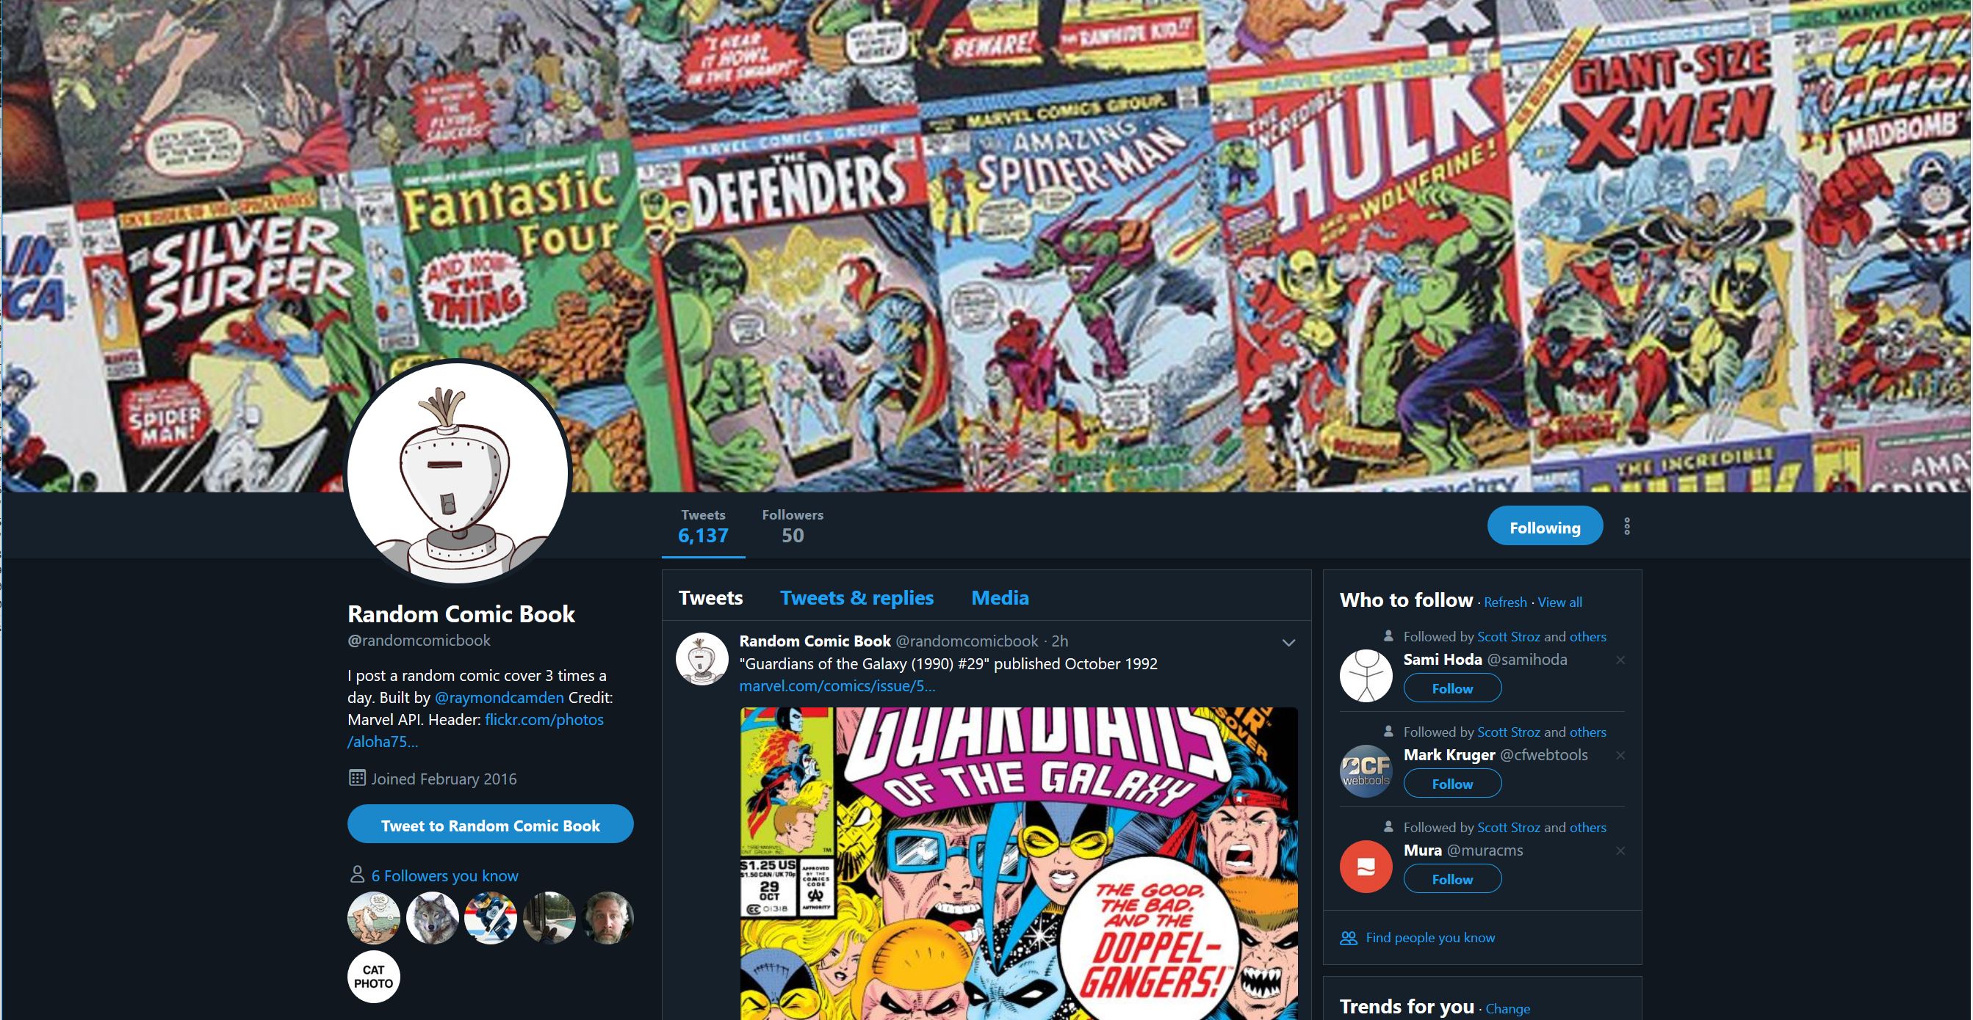

Slide 20
Can we get to a point?
Please?

Slide 21
A Point
Every programming language does the same dang thing
Every platform supports the same thing
Some languages / platforms are more inviting then others

Slide 22
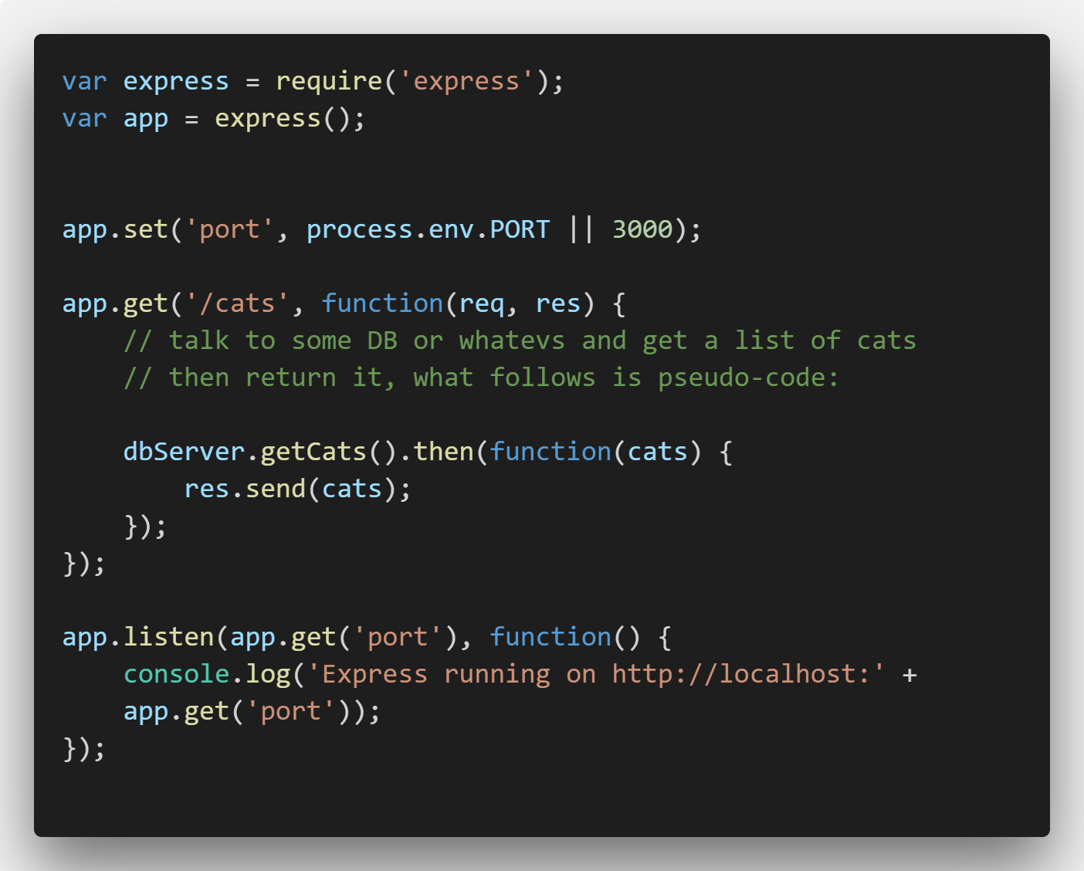
Not Serverless

Slide 23
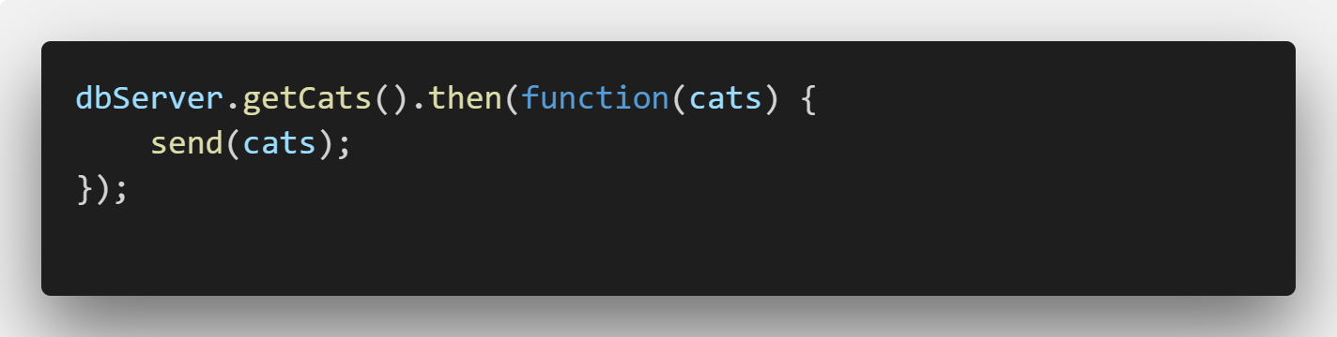
Serverless

Slide 24
Serverless with Webtask
Free to use
Sign up via Facebook, Google, GitHub, and Microsoft
Easiest serverless platform out there
Not the best platform
webtask.io

Slide 25
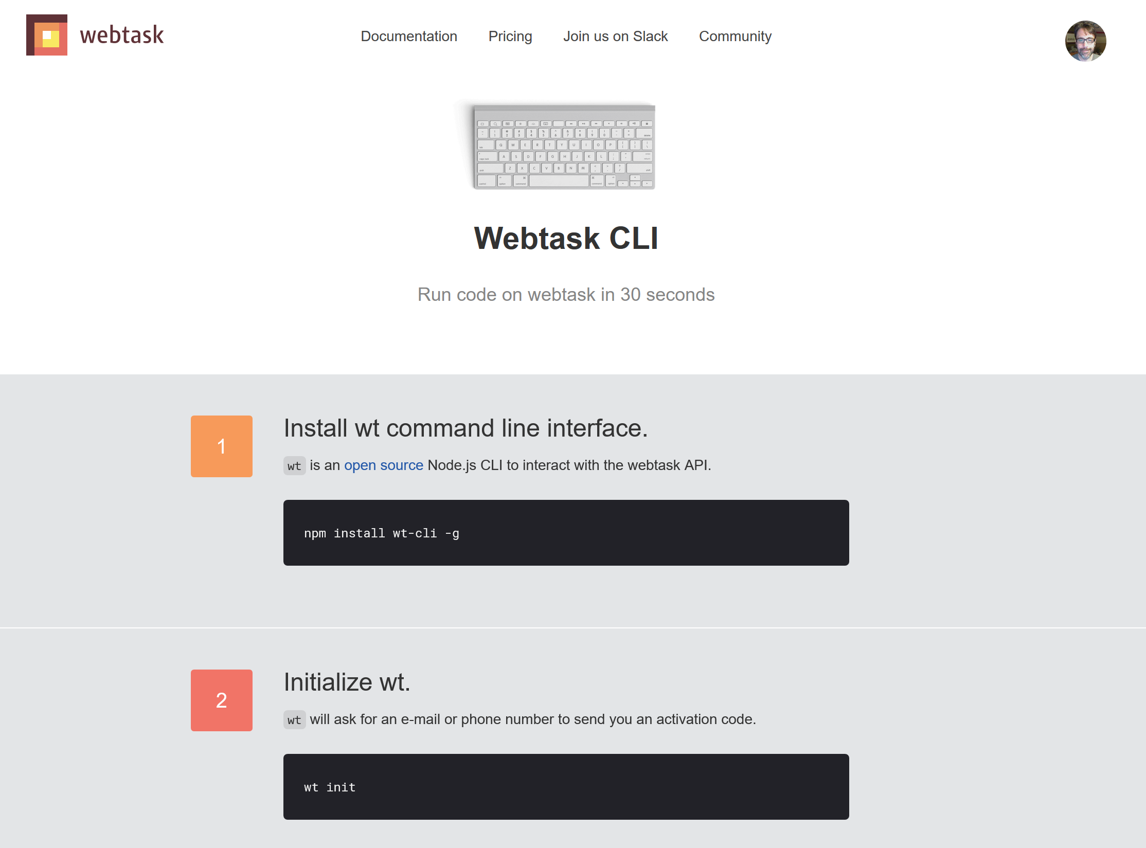

Slide 26
About that CLI...
Does everything I'm showing today
But I'm not showing it
You can work locally, test, debug
You can use your favorite editor
which is Visual Studio Code

Slide 27
Webtask Editor
https://webtask.io/make
List your files (and search)
Make new files (and delete stinky old ones)
Open files (duh), edit, full screen
Syntax highlighting, ESLint, Prettier
Dark theme!
Oh, and a full testing environment

Slide 28

Editor Tour!!!

Slide 29
Make the Serverless
Create the Webtask
Done*
* Some details may apply

Slide 30
Writing Webtasks
Three basic "forms" of your Webtask
JavaScript
Simple to Hipster Fancy Stuff

Slide 31
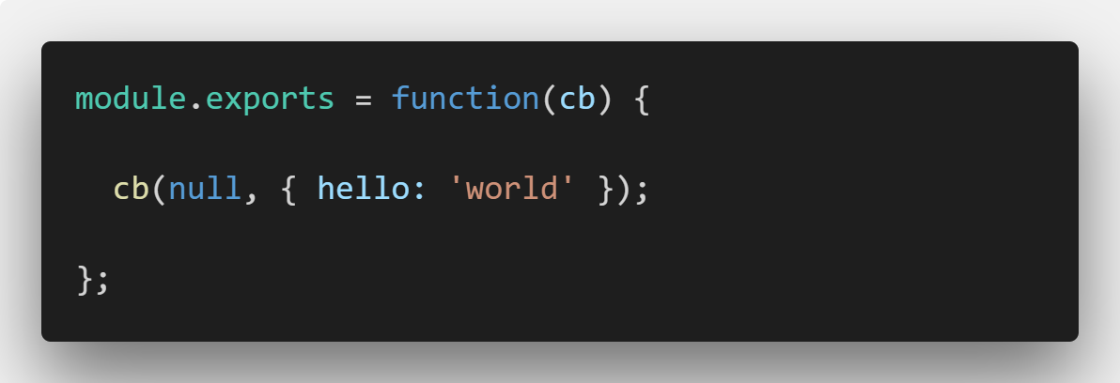
Basic Function Form

Slide 32
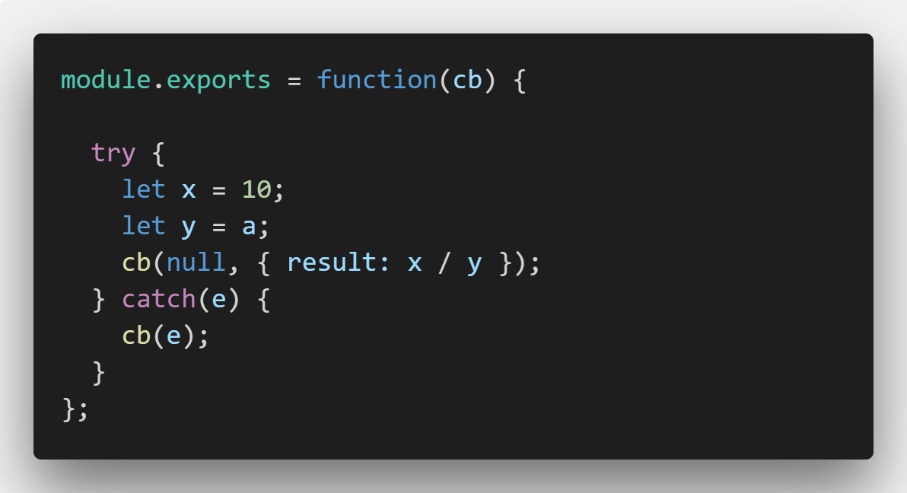
Basic Function Form

Slide 33
Demo
Ray, show preso_basic[1,2]

Slide 34
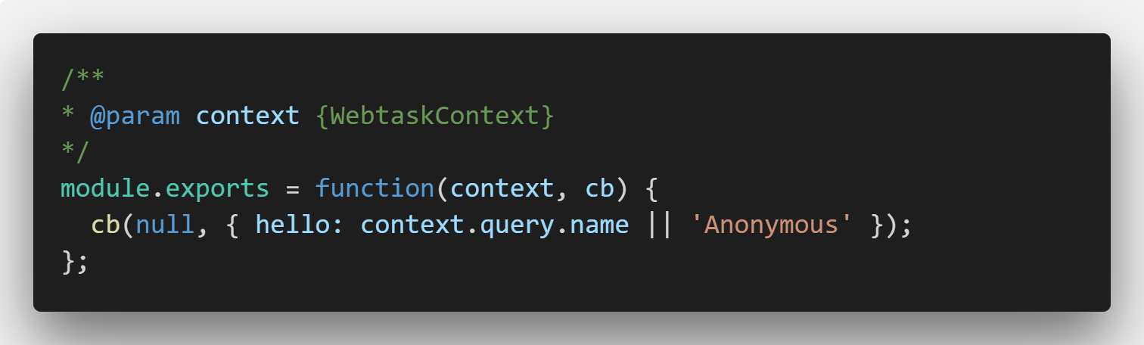
Context Form

Slide 35
Demo
Ray, show the basic default template

Slide 36
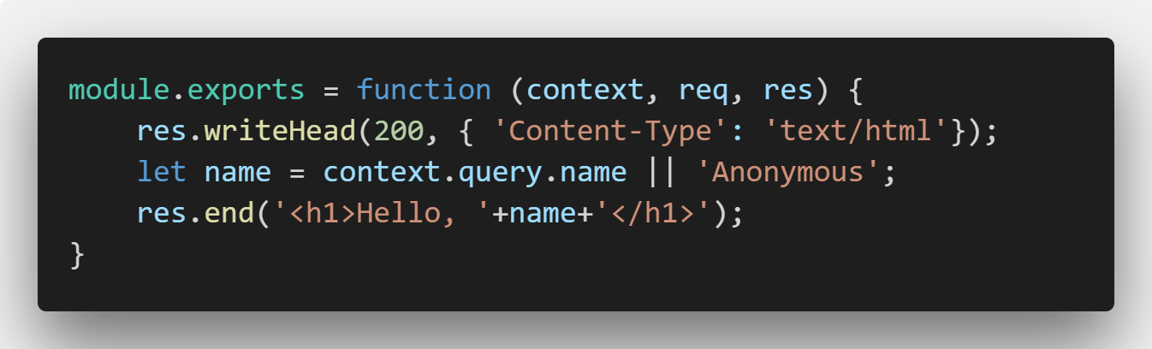
Full HTTP Control

Slide 37
Demo
Ray, show the stupid cat demo

Slide 38
Context
Query params (context.query)
Body params (context.body)
Headers (context.headers)
Meta (context.meta)
Secrets (context.secrets)

Slide 39
Demo
Show preso_body, preso_secret, and the HTML version cuz it is so cool

Slide 40

Storage

Slide 41
Storage
Simple object storage
To be clear - one object
No queries, no filters, zip
Conflict resolution (detection, really)
UI support
You can still use "real" persistence

Slide 42
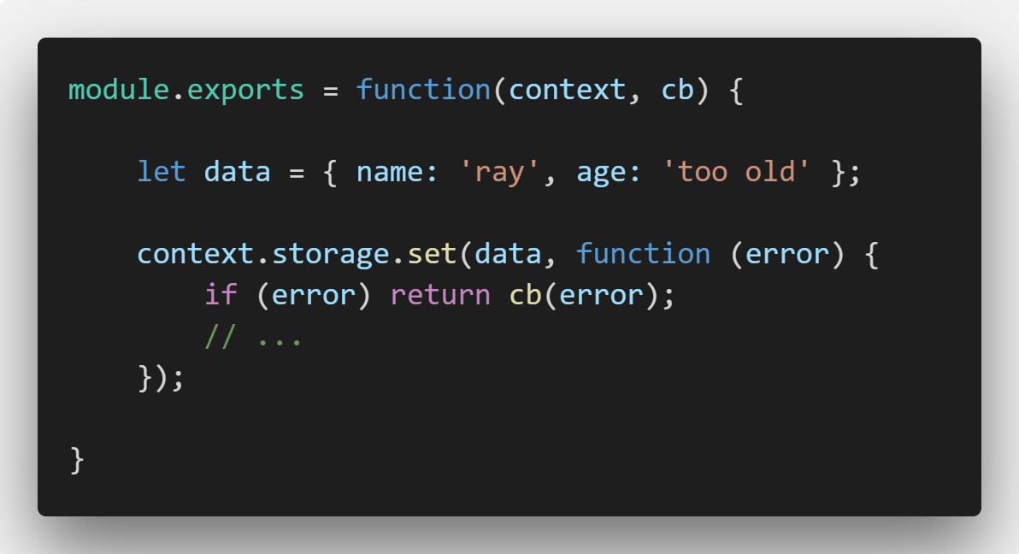
Storage - Writing

Slide 43
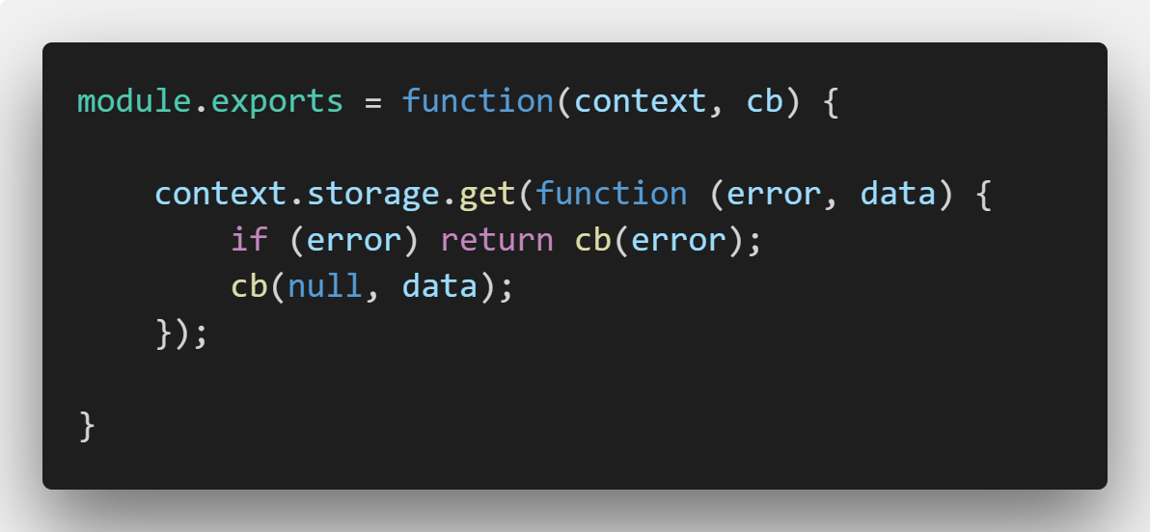
Storage - Reading

Slide 44
Storage Conflicts
Do “something” and run your set operation again
Force your updates

Slide 45
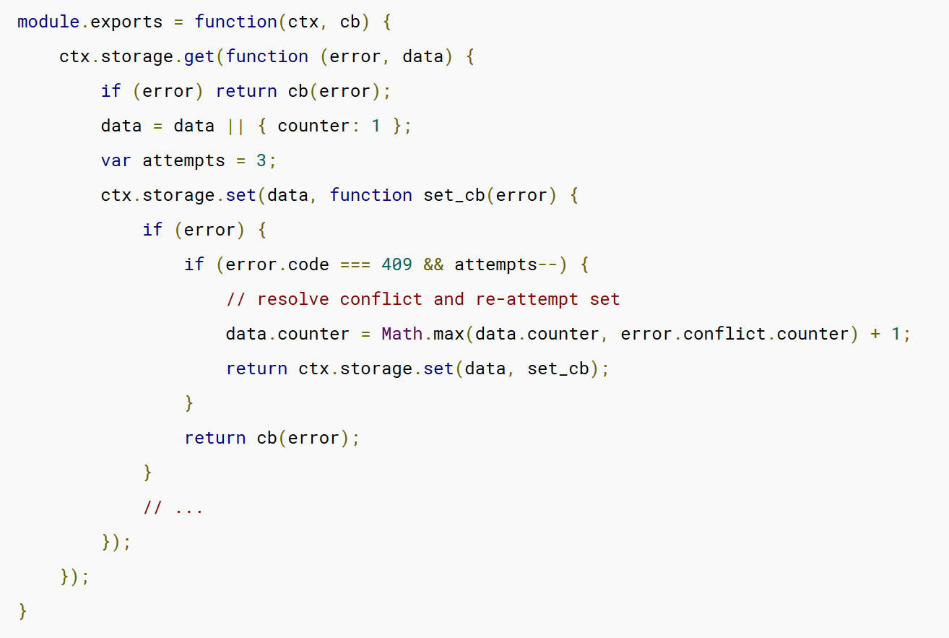
Example

Slide 46
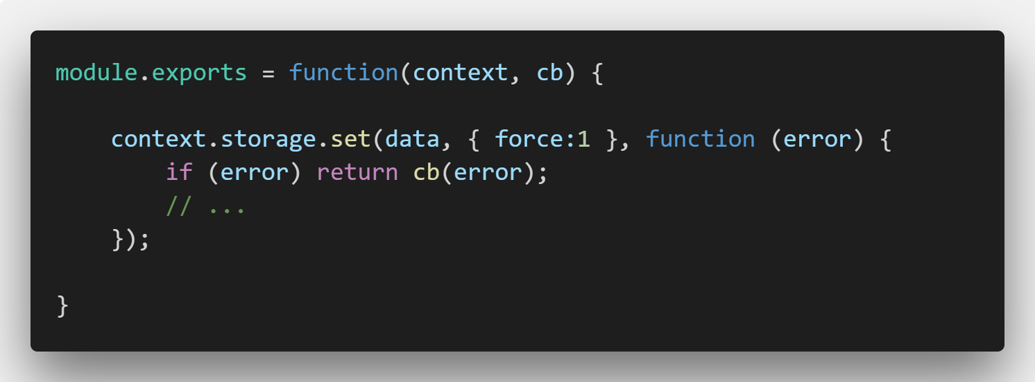
Storage Conflicts - Forced

Slide 47
Demo
Show preso_score and the neat front end

Slide 48
Middleware
If you’ve used middleware in Node apps – same! (Mostly)
Logic that runs before your Webtask
Examples:
Authentication
Modify/prepare data
Logic that creates new compilers
Change the ‘function’ form
Bypass the ‘regular’ NodeJS compiler

Slide 49
Middleware
Specified via the editor UI or via metadata
URL, npm module, or npm module export
For URLs, result must be text!

Slide 50
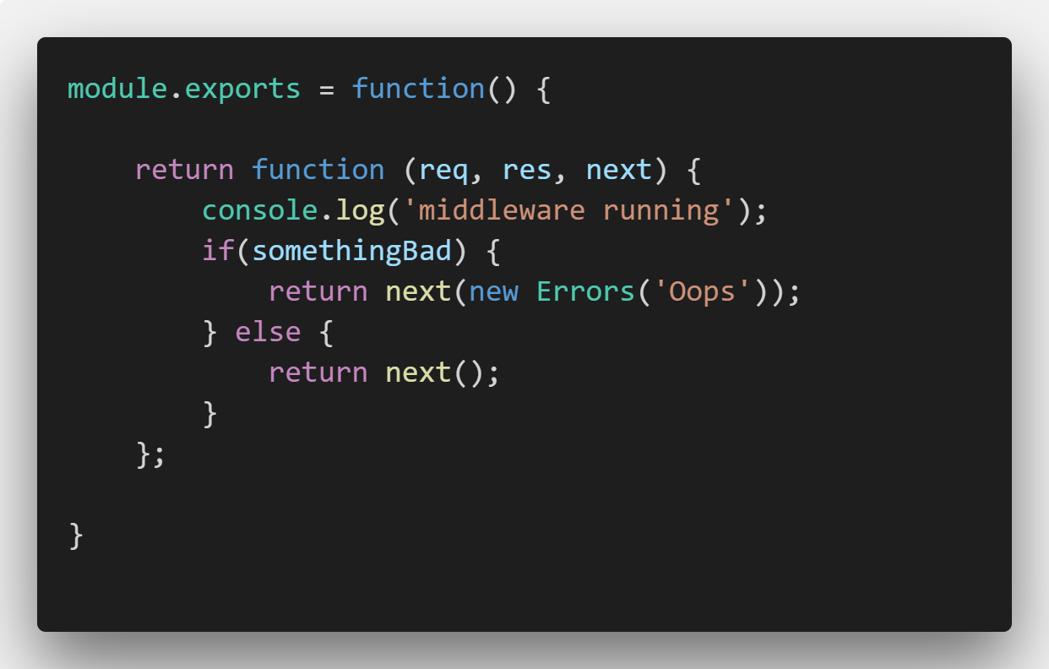
Middleware - Example

Slide 51
Middleware - More Details
You have access to the code of the webtask: req.webtaskContext.compiler.script
You have access to a JS compiler: req.webtaskContext.nodejsCompiler
https://webtask.io/docs/middleware
https://goextend.io/blog/using-alexa-with-webtask

Slide 52
Everything Else
NPM Modules
CRON Tasks
wt serve / wt debug
https://nodejs.org/en/docs/guides/debugging-getting-started/
wt logs

Slide 53
Why NOT to use Webtask?
Results
Chaining
No upgrade path
1 request per second soft limit
30 second execution limit
10 CRON Schedules
100kb of code per task (NPM modules don’t count)
500kb of storage via Storage API
https://webtask.io/docs/limits

Slide 54
Webtask Resources
Docs: https://webtask.io/docs
Slack: https://skynet.run.webtask.io/webtask-signup
Forum: https://community.webtask.io/
Blog: https://goextend.io/blog/tag/webtasks

Slide 55
Serverless Resources
Serverless Status
https://serverless.email
Serverless [Cron]icle
https://serverless.curated.co/
My own stuff:
https://www.raymondcamden.com/categories/serverless

Slide 56
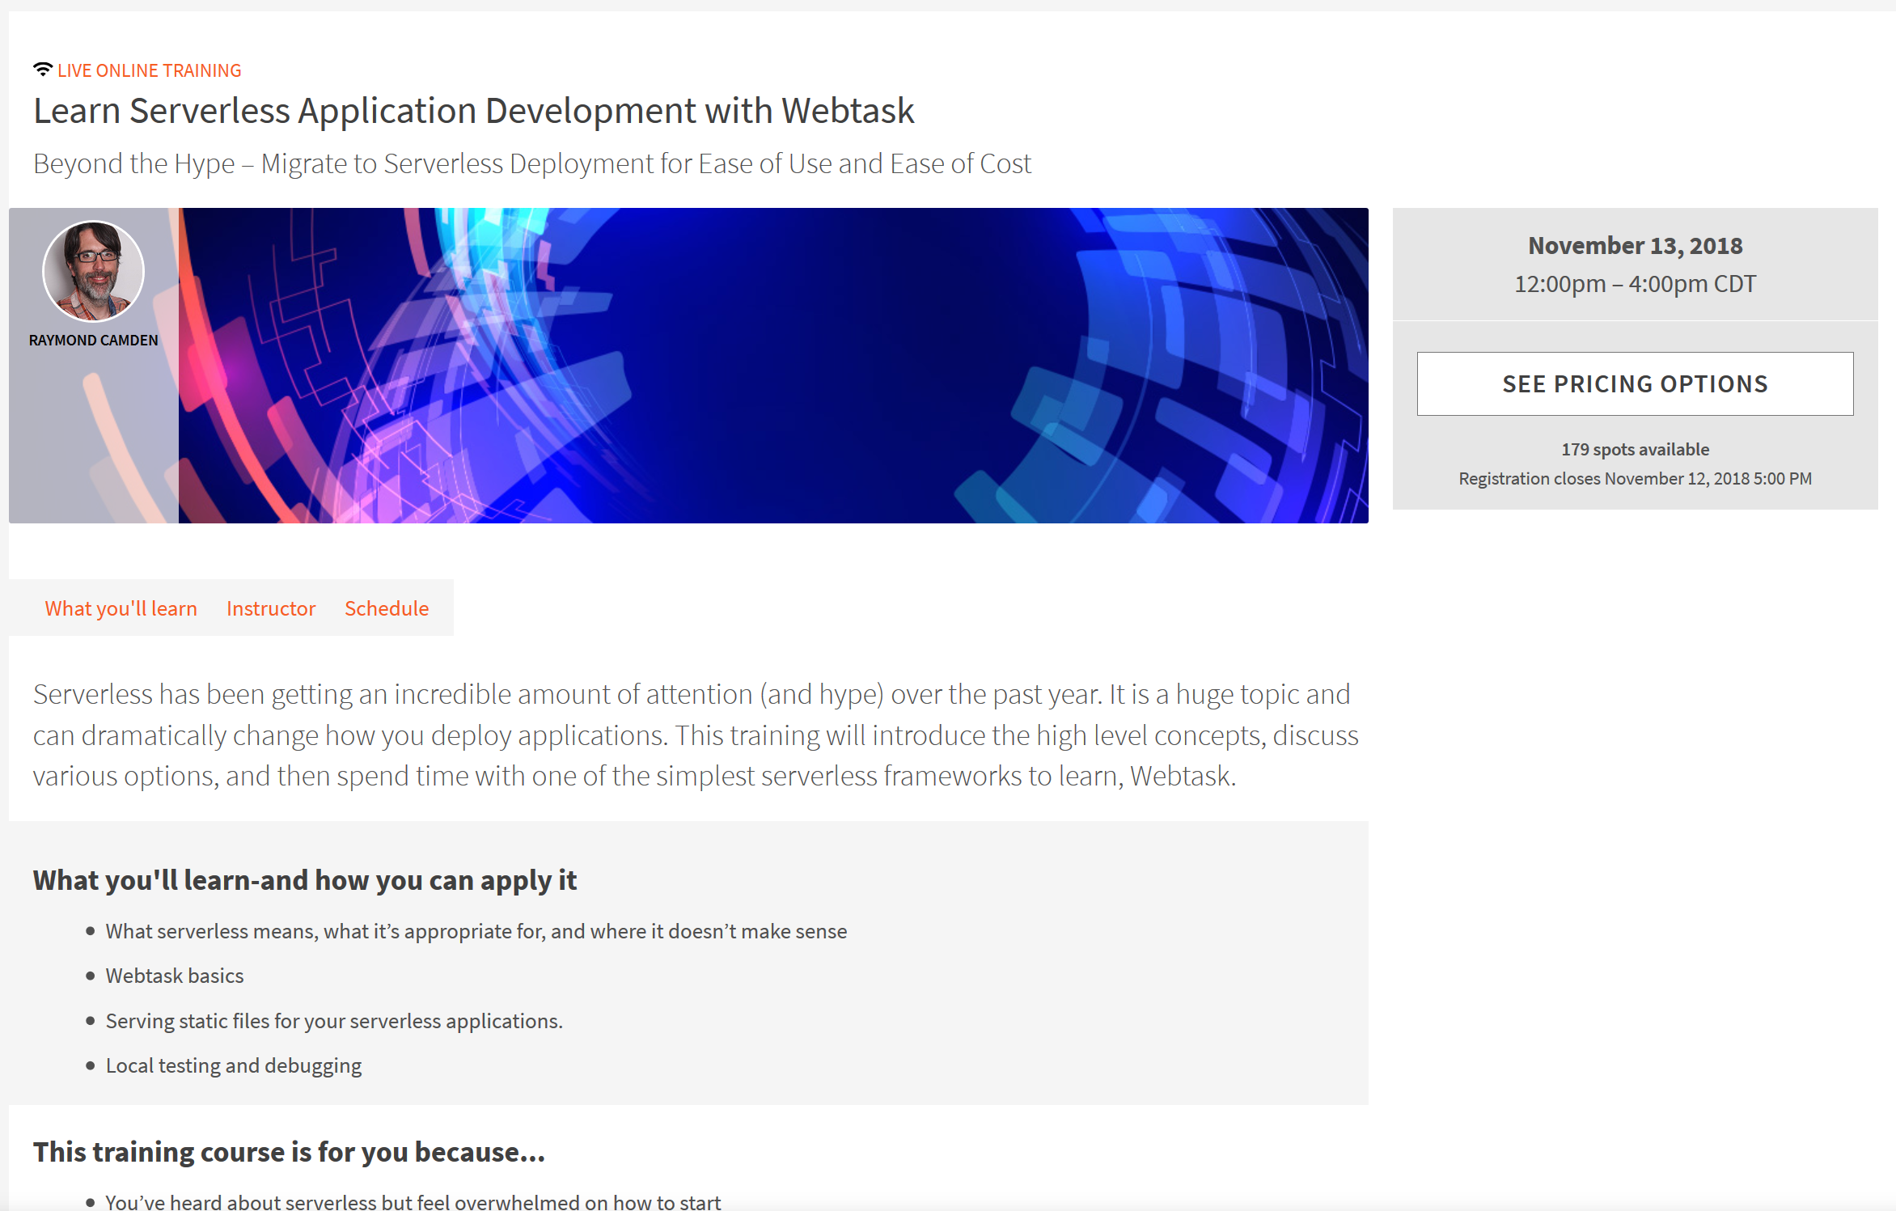
https://www.safaribooksonline.com/live-training/courses/learn-serverless-application-development-with-webtask/0636920217831/

Slide 57
Questions?
raymondcamden@gmail.com
www.raymondcamden.com
@raymondcamden

